Slide 1
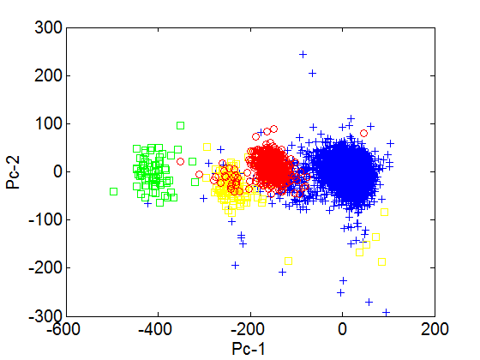
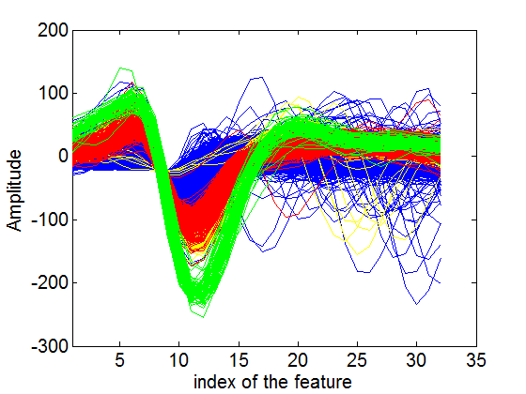
Experiment on the tanksort_waveforms
Experiment parameter
Burnin : 400; num: 200; Ncentres: 20; K : 32; Alignment position: 11; tuning paramter: 10⁴ .

Slide 2
Experiment on the new dataset
Experiment parameter
Burnin : 400; num: 200; Ncentres: 20; K : 32; Alignment position: 11;
Channel | 1 | 2 | 3 | 4 | 5 | 6
Parameter | 10⁴ | 10⁴ | 10² | 10⁴ | 10⁵ | 10⁴
Parameter choice :a set of value (10, 10² ,10³ , 10⁴ , 10⁵, 10⁶ ) can be tested; In general, the larger the parameter is, the more the cluster number is.

Slide 3
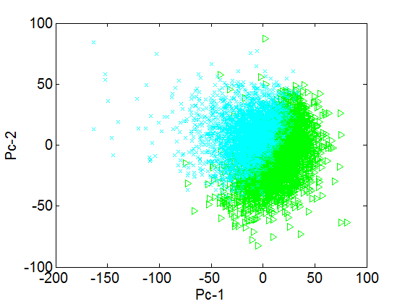
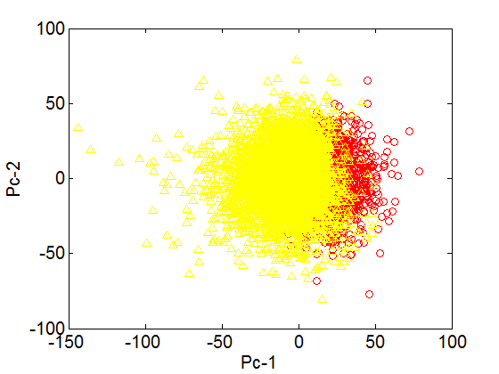
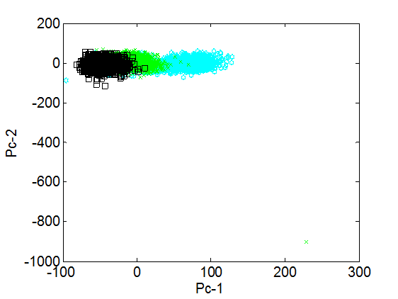
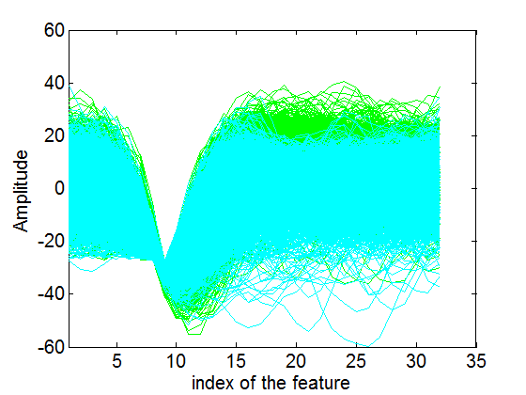
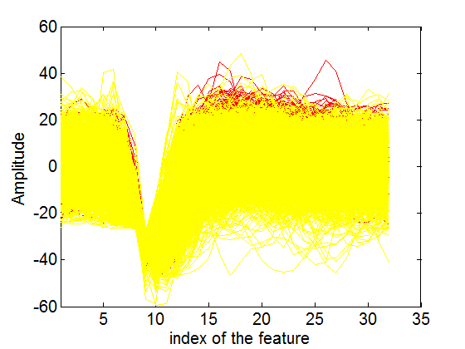
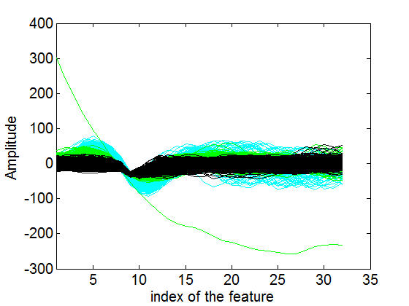
Experiment on the new dataset
Channel-1
Channel-2
Channel-3

Slide 4
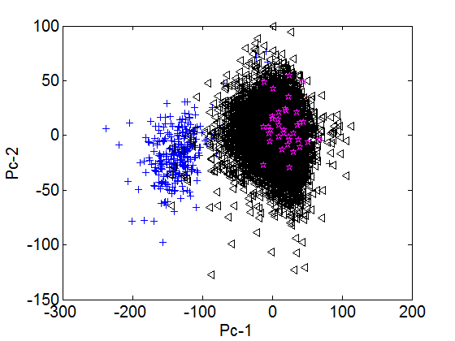
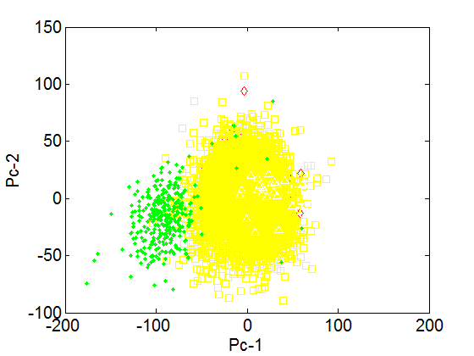
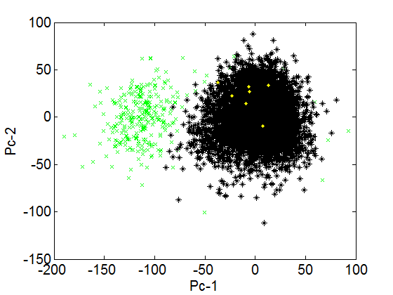
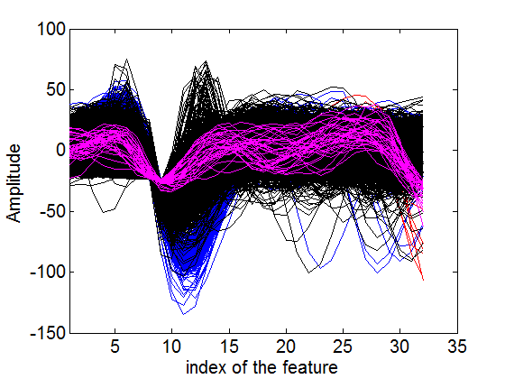
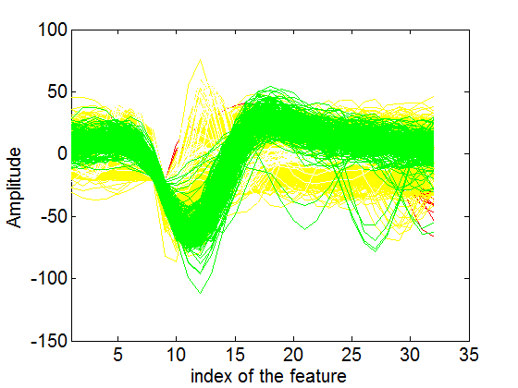
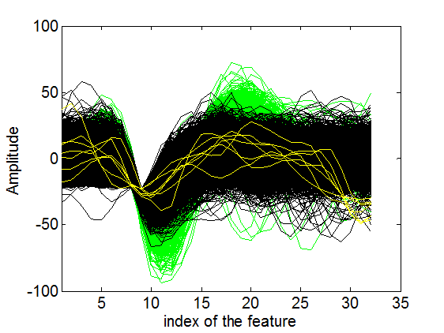
Experiment on the new dataset
Channel-4
Channel-5
Channel-6

